Slide 1


Cause of Death
Presented by
Naveen Kumar Ranganathan

Slide 2

ACKNOWLEDGMENT
I would like to thank Flip Robo Technologies who gave me this opportunity to work on Cause of Death Project which helped me to gain in-depth knowledge of EDA Analysis in Data Science to derive insights for organizational goals to meet business needs.
Also, I have utilized a few external resources which helped me to complete this project. All the external resources that were used in creating this project are listed below:
https://ourworldindata.org/causes-of-death-treemap
https://github.com/
https://www.w3schools.com/
https://matplotlib.org/
https://www.geeksforgeeks.org/
https://seaborn.pydata.org/

Slide 3
INTRODUCTION
Business Problem Framing
To make progress towards a healthier world we need to have a good understanding of what health problems we face today. What do people die from?
With the dataset we can identify the major problems which causes death.
Conceptual Background of the Domain Problem
Case Study on Cause of Death:
A straightforward way to assess the health status of a population is to focus on mortality – or concepts like child mortality or life expectancy, which are based on mortality estimates. A focus on mortality, however, does not take into account that the burden of diseases is not only that they kill people, but that they cause suffering to people who live with them. Assessing health outcomes by both mortality and morbidity (the prevalent diseases) provides a more encompassing view on health outcomes. This is the topic of this entry. The sum of mortality and morbidity is referred to as the ‘burden of disease’ and can be measured by a metric called ‘Disability Adjusted Life Years‘ (DALYs). DALYs are measuring lost health and are a standardized metric that allow for direct comparisons of disease burdens of different diseases across countries, between different populations, and over time. Conceptually, one DALY is the equivalent of losing one year in good health because of either premature death or disease or disability. One DALY represents one lost year of healthy life. The first ‘Global Burden of Disease’ (GBD) was GBD 1990 and the DALY metric was prominently featured in the World Bank’s 1993 World Development Report. Today it is published by both the researchers at the Institute of Health Metrics and Evaluation (IHME) and the ‘Disease Burden Unit’ at the World Health Organization (WHO), which was created in 1998. The IHME continues the work that was started in the early 1990s and publishes the Global Burden of Disease study.

Slide 4
INTRODUCTION
Business Problem Framing
To make progress towards a healthier world we need to have a good understanding of what health problems we face today. What do people die from?
With the dataset we can identify the major problems which causes death.
Conceptual Background of the Domain Problem
Case Study on Cause of Death:
A straightforward way to assess the health status of a population is to focus on mortality – or concepts like child mortality or life expectancy, which are based on mortality estimates. A focus on mortality, however, does not take into account that the burden of diseases is not only that they kill people, but that they cause suffering to people who live with them. Assessing health outcomes by both mortality and morbidity (the prevalent diseases) provides a more encompassing view on health outcomes. This is the topic of this entry. The sum of mortality and morbidity is referred to as the ‘burden of disease’ and can be measured by a metric called ‘Disability Adjusted Life Years‘ (DALYs). DALYs are measuring lost health and are a standardized metric that allow for direct comparisons of disease burdens of different diseases across countries, between different populations, and over time. Conceptually, one DALY is the equivalent of losing one year in good health because of either premature death or disease or disability. One DALY represents one lost year of healthy life. The first ‘Global Burden of Disease’ (GBD) was GBD 1990 and the DALY metric was prominently featured in the World Bank’s 1993 World Development Report. Today it is published by both the researchers at the Institute of Health Metrics and Evaluation (IHME) and the ‘Disease Burden Unit’ at the World Health Organization (WHO), which was created in 1998. The IHME continues the work that was started in the early 1990s and publishes the Global Burden of Disease study.

Slide 5
INTRODUCTION
Review of Literature
In everyday language we sometimes say that a person died of ‘old age’ or that they ‘died of natural causes’. But there is always an underlying cause that stopped their body from functioning. When the cause of death is not recorded then researchers rely on models to estimate the cause.
Motivation for the Problem Undertaken
What the world dies from is not what is reflected in the media. Some major causes of deaths receive very little attention. Analysing and studying the dataset will give us good understanding of what health problems we face today. We need a good sense of the relative importance of different causes of death and we need to focus our efforts on the biggest causes..

Slide 6
Analytical Problem Framing
Data Set Content:
In this Dataset, we have Historical Data of different cause of deaths for all ages around the World. The key features of this Dataset are: Meningitis, Alzheimer's Disease and Other Dementias, Parkinson's Disease, Nutritional Deficiencies, Malaria, Drowning, Interpersonal Violence, Maternal Disorders, HIV/AIDS, Drug Use Disorders, Tuberculosis, Cardiovascular Diseases, Lower Respiratory Infections, Neonatal Disorders, Alcohol Use Disorders, Self-harm, Exposure to Forces of Nature, Diarrheal Diseases, Environmental Heat and Cold Exposure, Neoplasms, Conflict and Terrorism, Diabetes Mellitus, Chronic Kidney Disease, Poisonings, Protein-Energy Malnutrition, Road Injuries, Chronic Respiratory Diseases, Cirrhosis and Other Chronic Liver Diseases, Digestive Diseases, Fire, Heat, and Hot Substances, Acute Hepatitis.
Getting insights about the dataset:
Imported below required libraries to work on the dataset
import numpy as np
import pandas as pd
import matplotlib.pyplot as plt
import seaborn as sns
import sklearn
from sklearn import preprocessing
import warnings
warnings.filterwarnings('ignore')

Slide 7
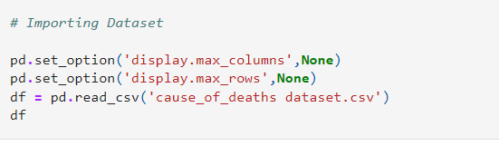
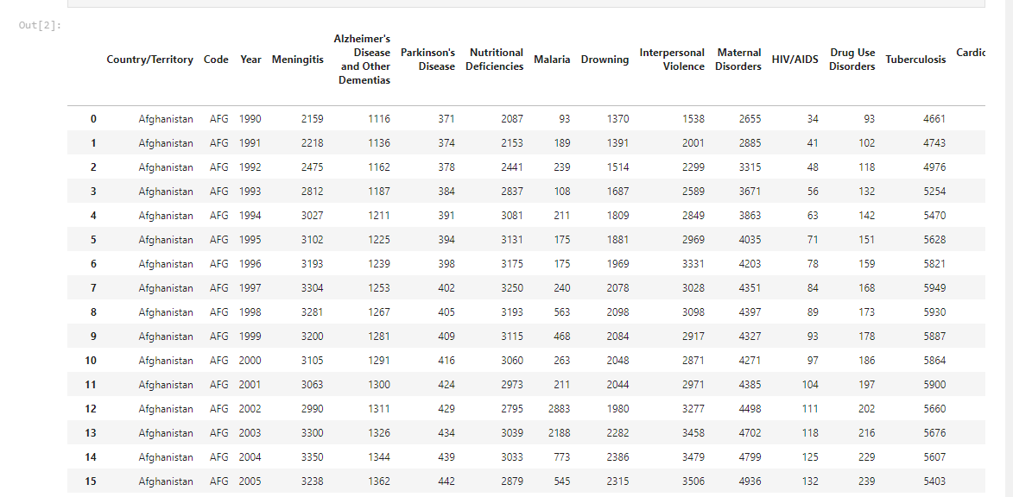
Analytical Problem Framing
Using Pandas the csv file of the dataset was imported

Slide 8
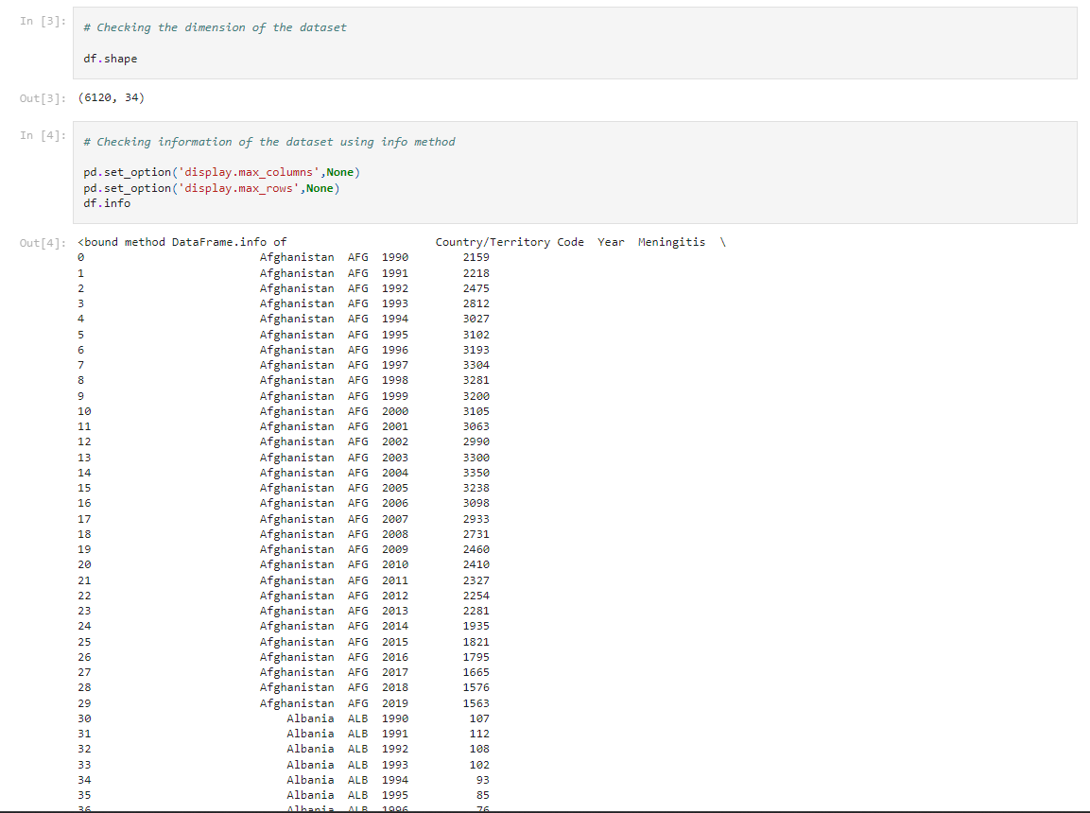
Analytical Problem Framing
Checking dimension and information of the dataset
To identify the dimension of our dataset, used shape() method and found that our
dataset contains 6120 columns and 34 rows

Slide 9
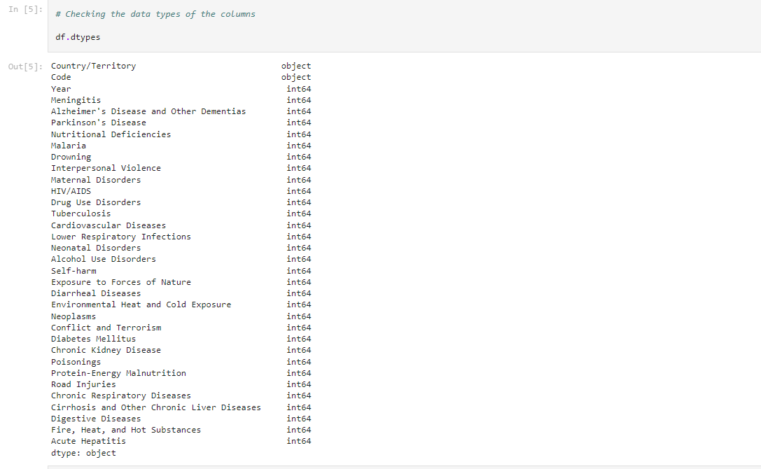
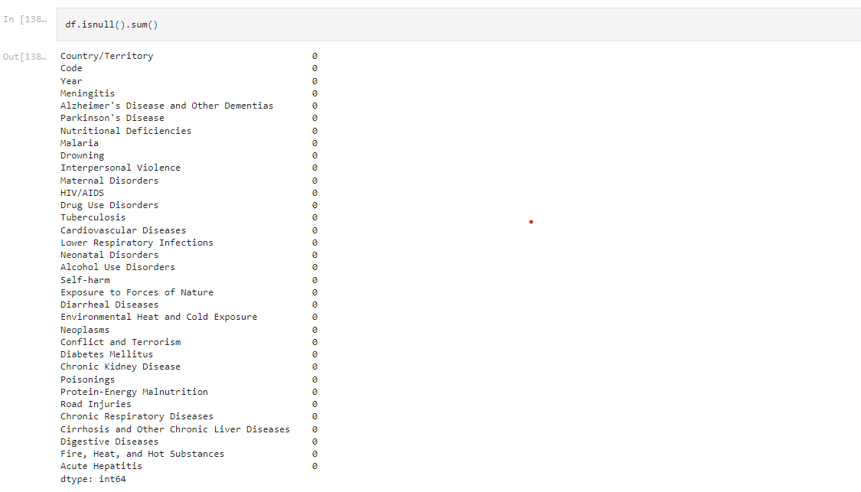
Analytical Problem Framing
Used dtypes method to identify the data types of the dataset and found all the columns are int type except Country/Territory and Code which are object type
Used isnull().sum() to identify null values and we don’t find any null values in our dataset

Slide 10
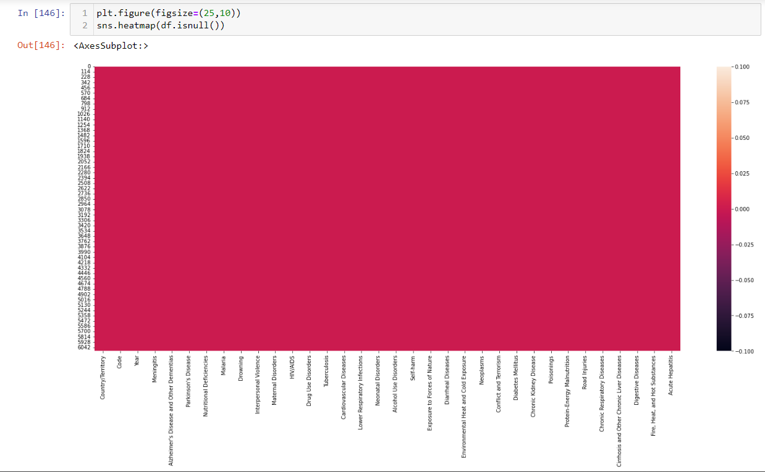
Analytical Problem Framing
Visualizing null values in heatmap

Slide 11
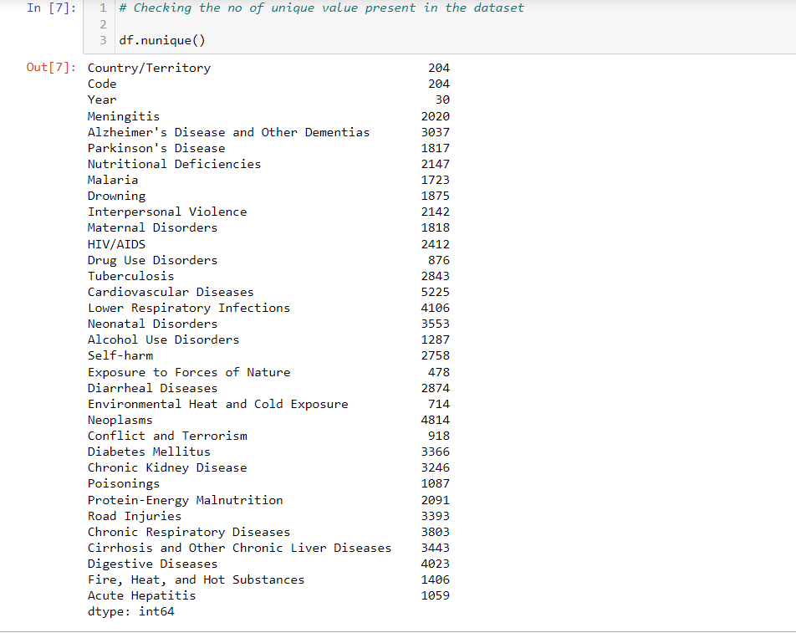
Analytical Problem Framing
Used nunique() function to identify the uniqueness of the value present in the dataset

Slide 12
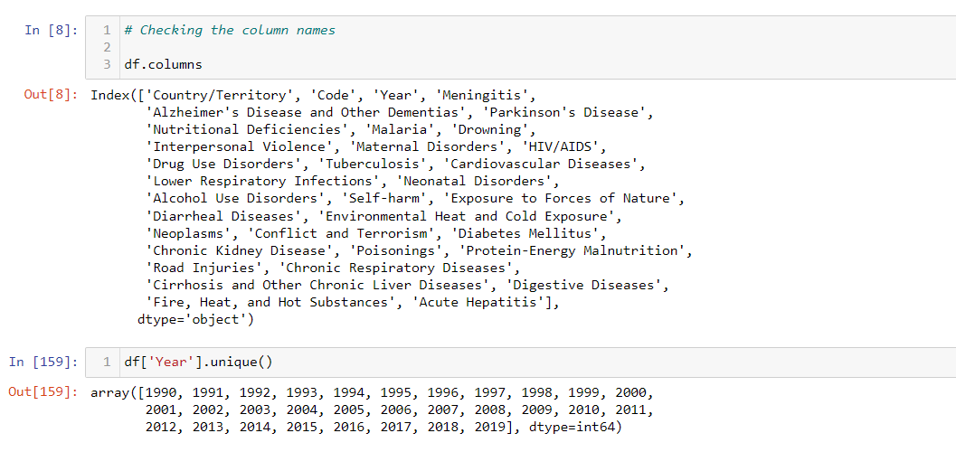
Analytical Problem Framing
Checking on the columns present in the dataset
Dataset contains data from 1990 to 2019

Slide 13
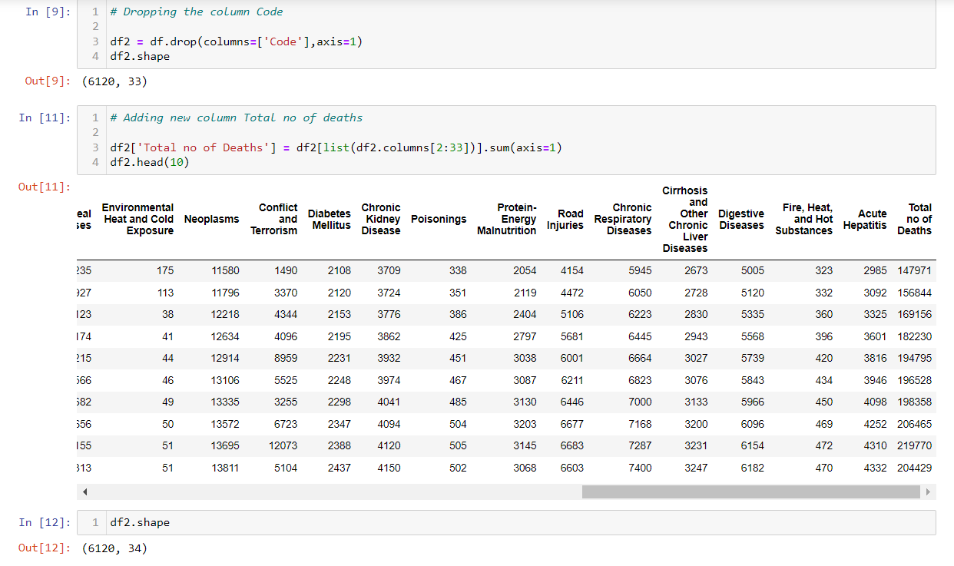
Analytical Problem Framing
Dropped column code as we have Country/Territory both denotes the same information
Added Total no of Deaths column to understand total deaths documented by year and country

Slide 14
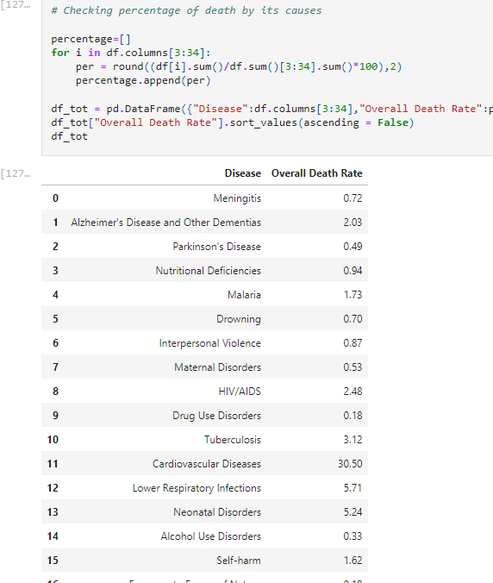
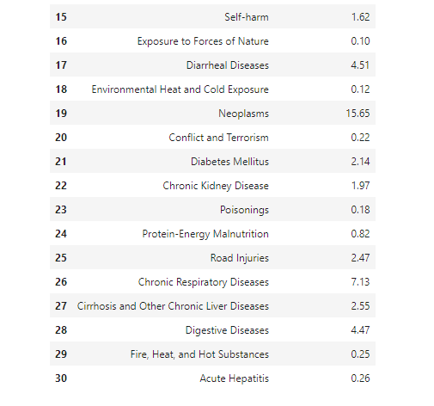
Data Visualization:
Checking percentage of death by
causes

Slide 15
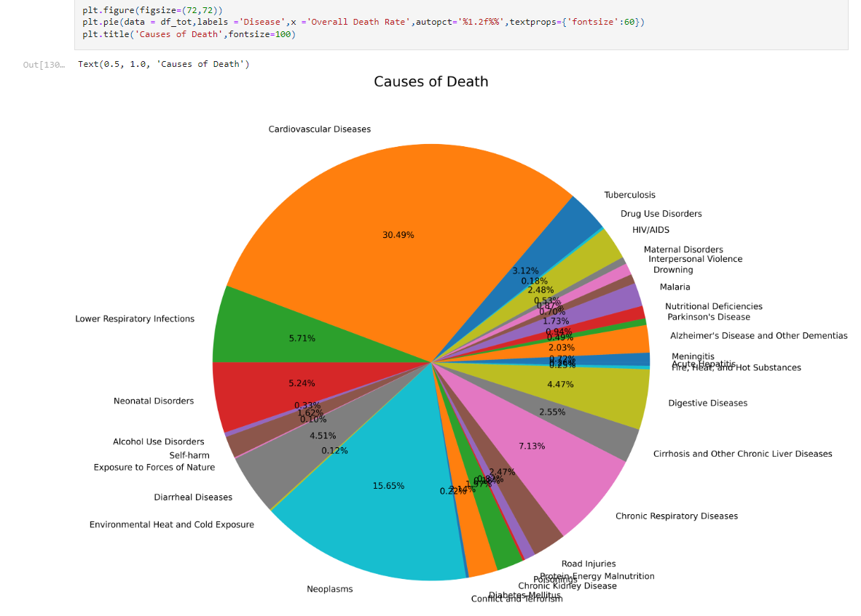
Data Visualization:
Cardiovascular Diseases deaths is the highest in the world with 30.49% across all the deaths documented followed by Neoplasms with 15.65%
Exposure to Forces of Nature 0.10%, Environmental Heat and Cold Exposure 0.12% and Poisonings 0.18% are the lowest in deaths

Slide 16
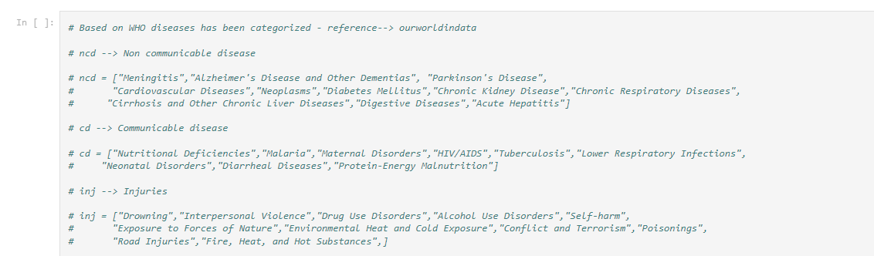
Data Visualization:
Based on our dataset we can group the causes of deaths into three large categories
Non-communicable diseases
Diseases which cannot be passed from person to person
Communicable or infectious diseases
Diseases that are caused by a pathogen which can be passed from person to person
Injuries
This is a very wide category which includes accidents – such as car crashes and falls from stairs or ladders – as well as intentional injuries like homicides, war deaths, and suicides.

Slide 17
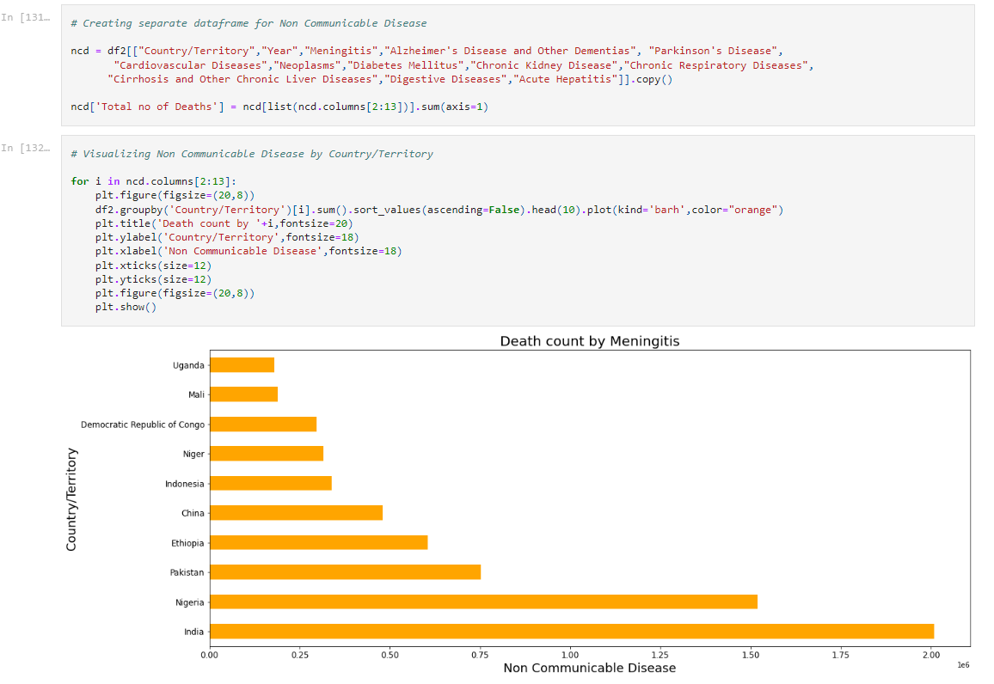
Data Visualization:
Visualizing Non Communicable Disease
Non-communicable Diseases:
"Meningitis","Alzheimer's Disease and Other Dementias", "Parkinson's Disease",
"Cardiovascular,Diseases","Neoplasms","Diabetes Mellitus","Chronic Kidney Disease","Chronic Respiratory Diseases","Cirrhosis and Other Chronic Liver Diseases","Digestive Diseases","Acute Hepatitis"

Slide 18
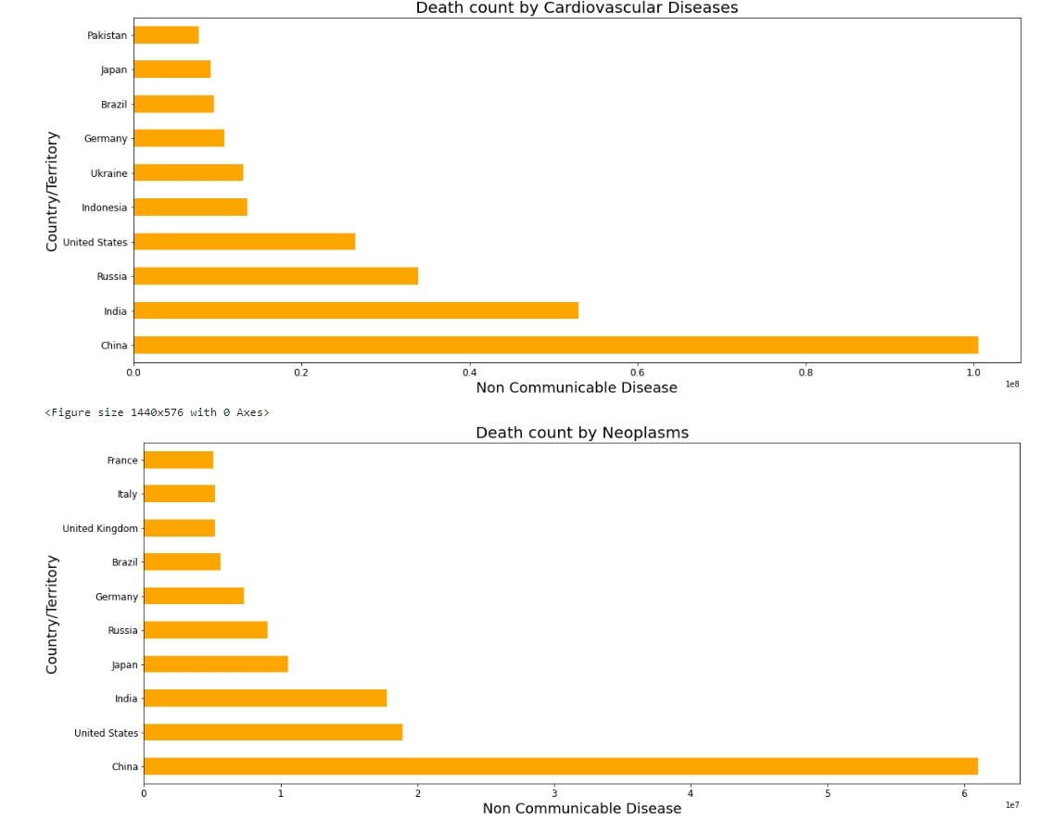
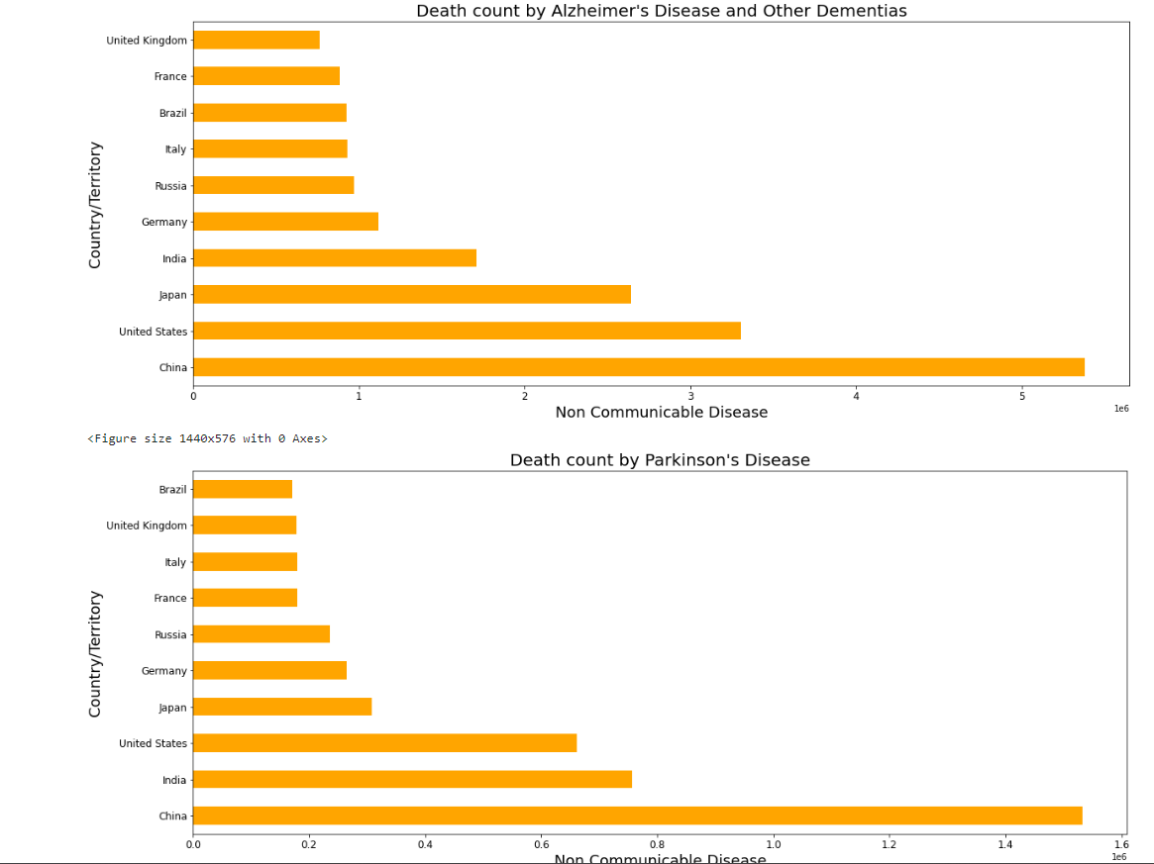
Data Visualization:
Non-communicable Diseases:

Slide 19
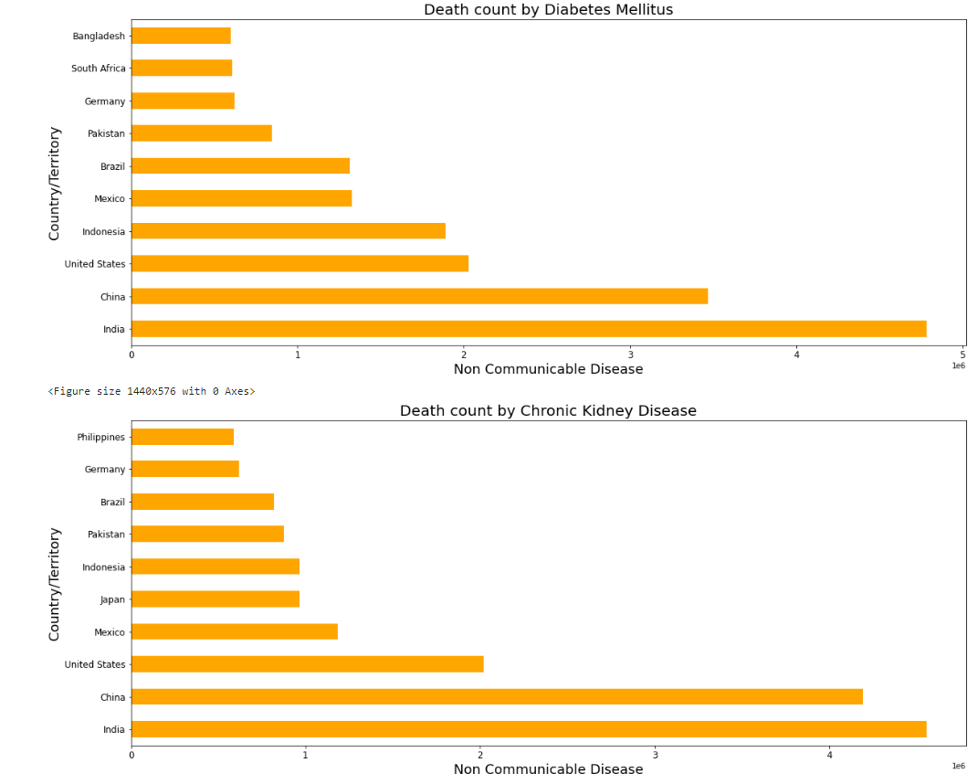
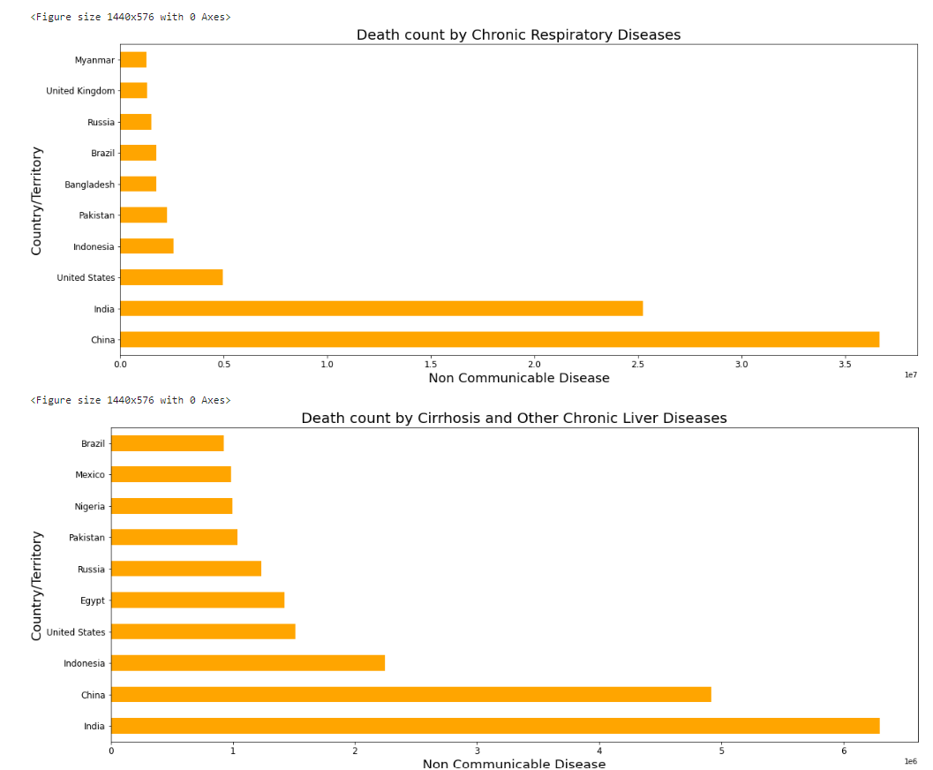
Data Visualization:
Non-communicable Diseases:

Slide 20
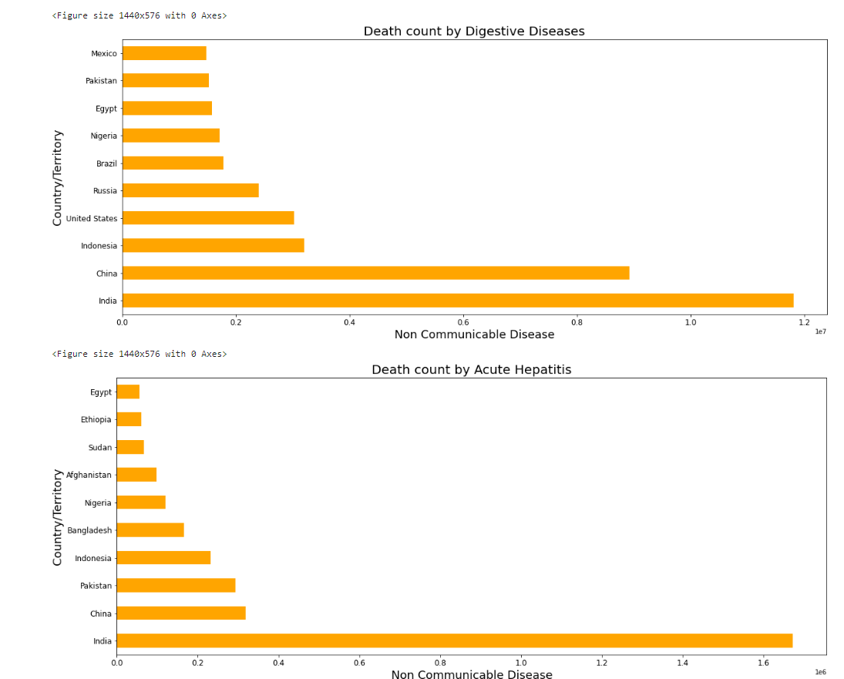
Data Visualization:
Non-communicable Diseases:
Meningitis death count is reported high in India, Nigeria and low in Uganda
Alzheimer's Disease and Other Dementias death count is reported high in China followed
by United States and reported low in United
Kingdom
Parkinson's Disease death count is reported high in China, India and low in Brazil
Cardiovascular Diseases death count is reported very high in China and India followed by Russia
Neoplasms death count is reported very high in China and very low in France
Diabetes Mellitus death count is reported high in India and China
Chronic Kidney Disease death count is very high and almost equal in India and China
Chronic Respiratory Diseases death rate is very high in China and India
Cirrhosis and Other Chronic Liver Diseases and Digestive Diseases death counts are very
high both in India and China
Death by Acute Hepatitis in India is the highest among all the other countries

Slide 21
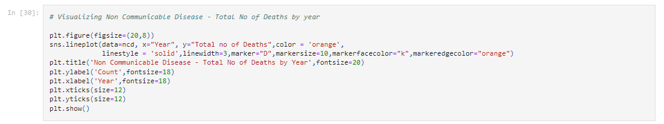
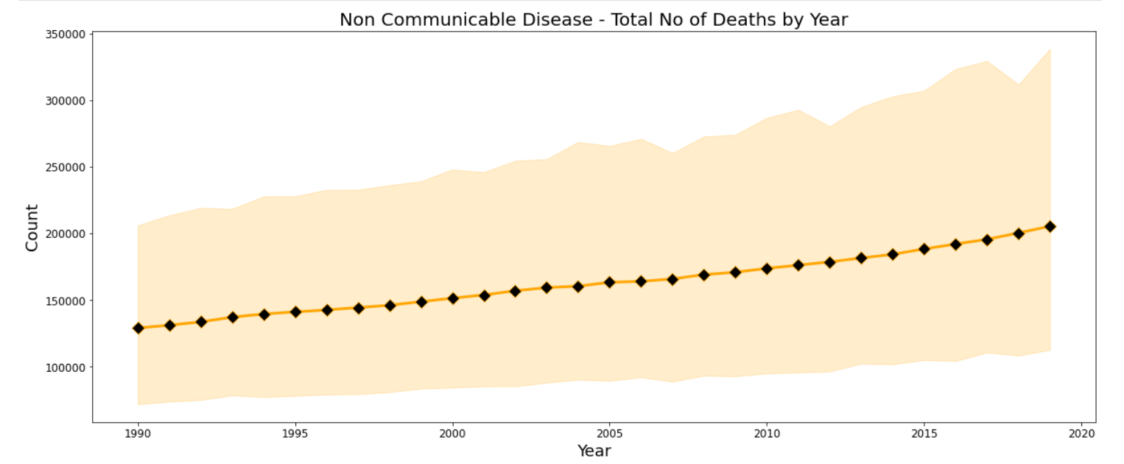
Data Visualization:
Non-communicable Diseases:
As we see the most of death by Non Communicable Disease is very high in India and China, this is due to high density of population in both the country
Line plot chart shows us that death by Non Communicable disease is increasing yearly
based on the data from 1990 to 2019

Slide 22
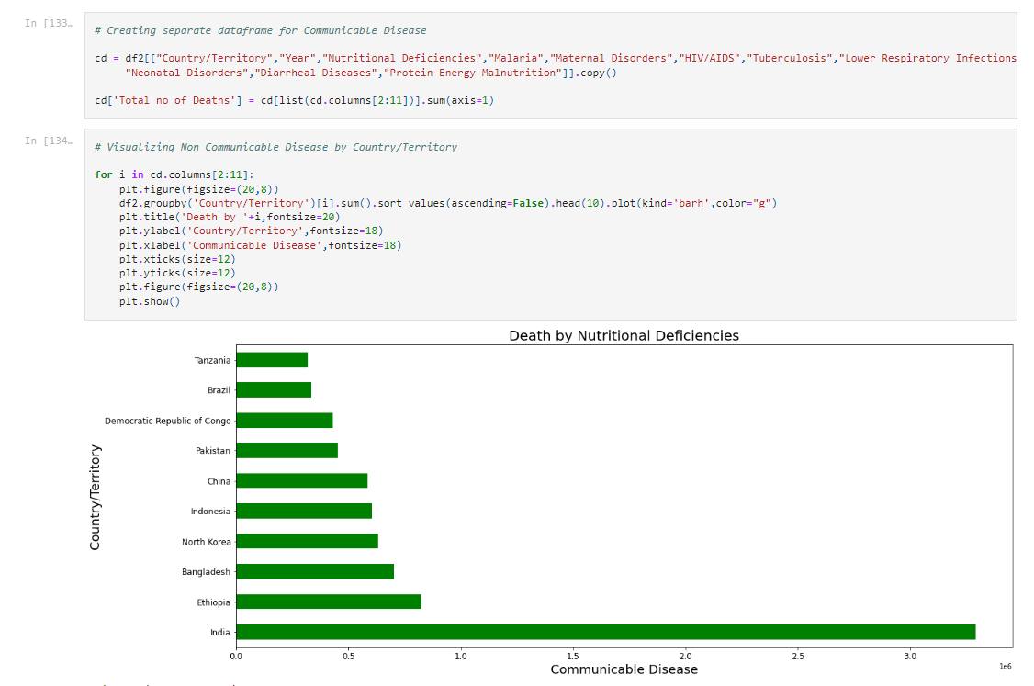
Data Visualization:
Communicable Diseases: Nutritional Deficiencies","Malaria","Maternal Disorders","HIV/AIDS","Tuberculosis","Lower Respiratory Infections","Neonatal Disorders","Diarrheal Diseases","Protein-Energy Malnutrition”

Slide 23
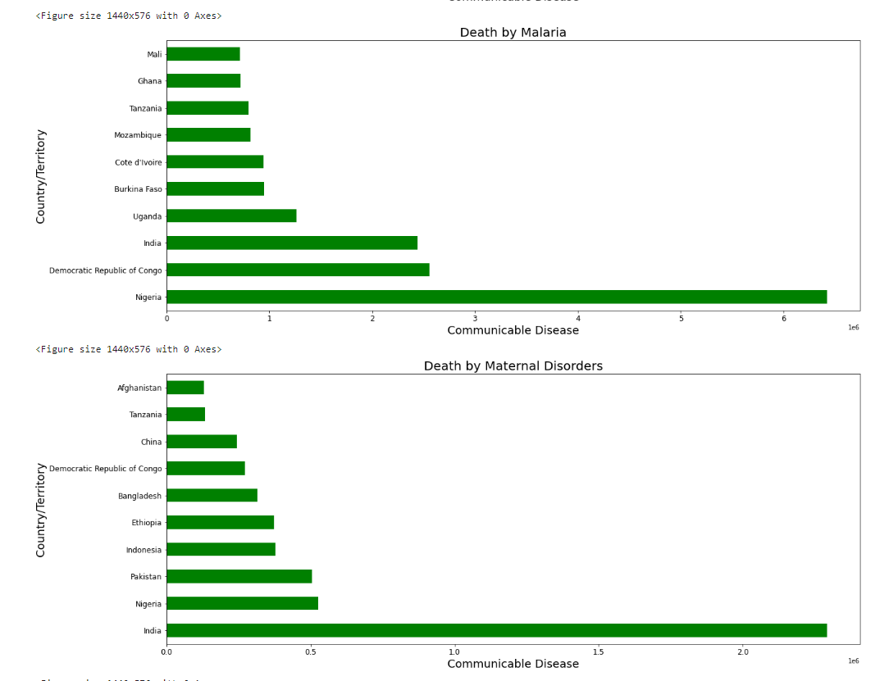
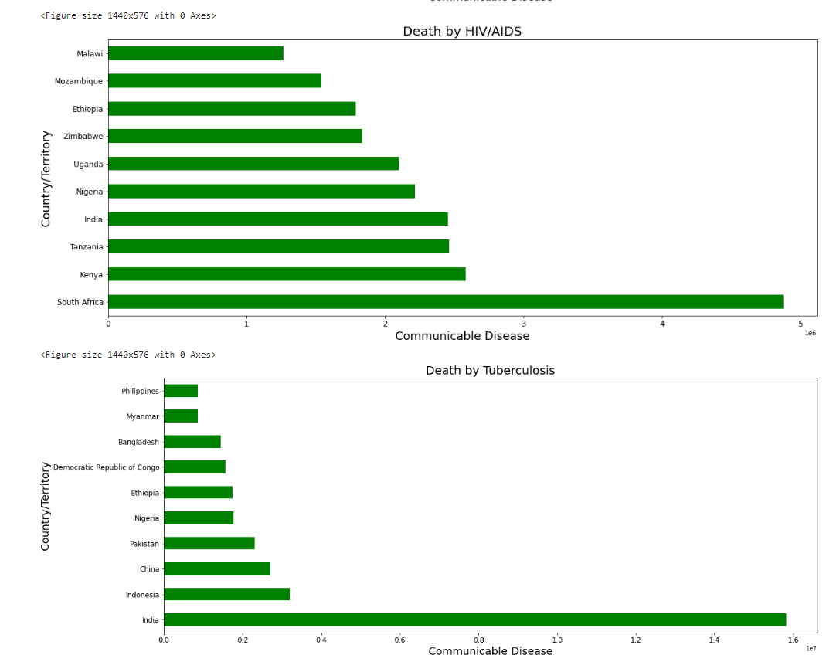
Data Visualization:
Communicable Diseases:

Slide 24
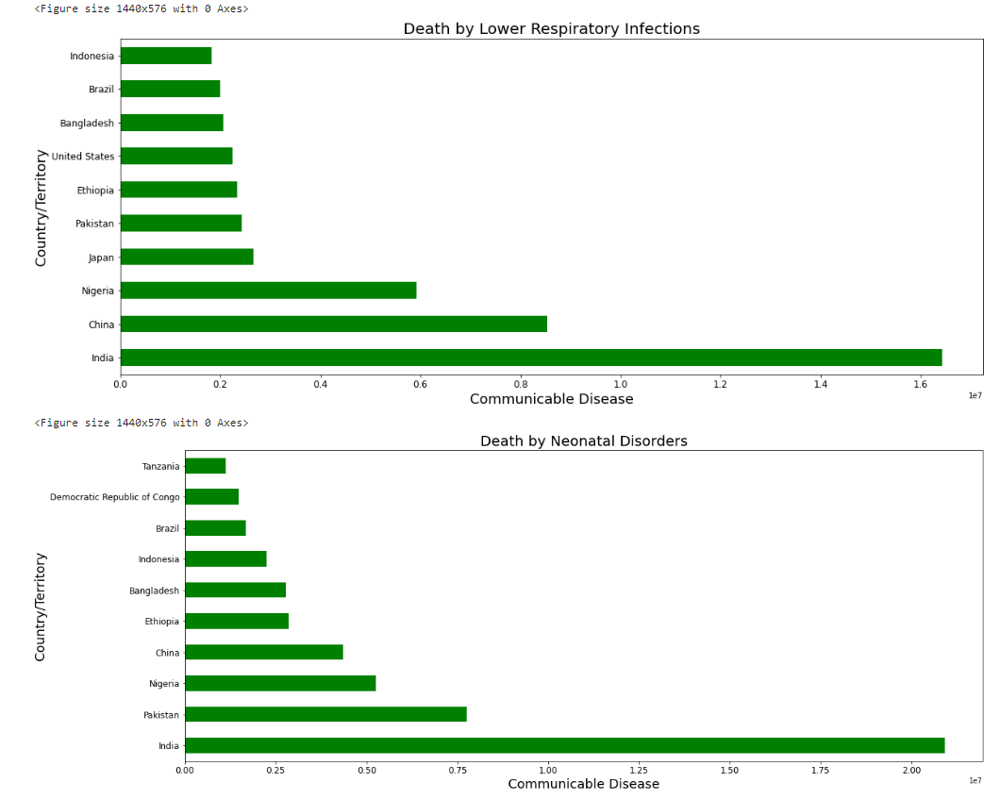
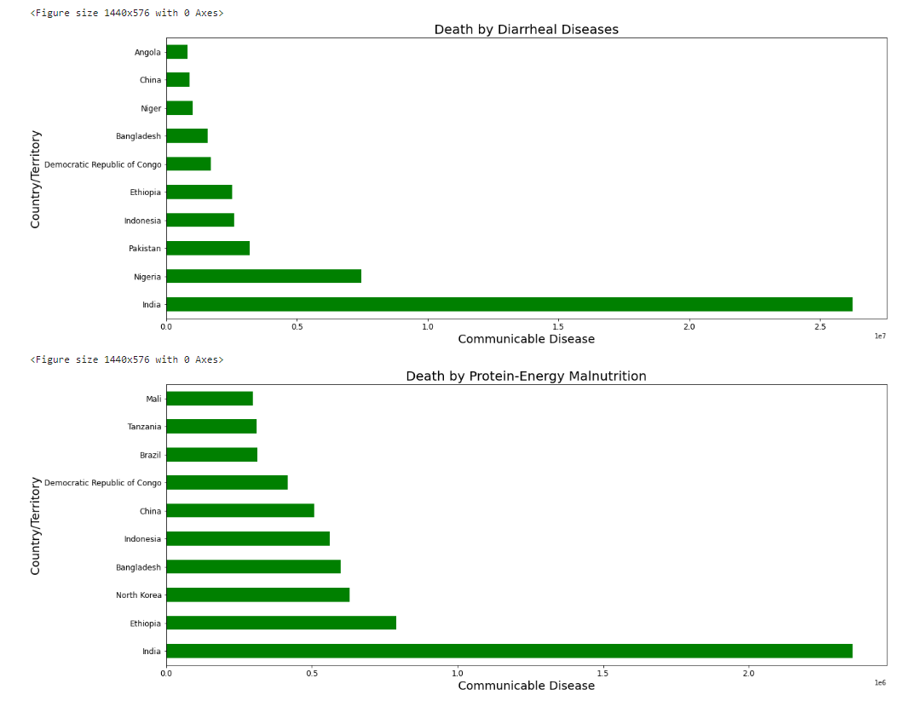
Data Visualization:
Communicable Diseases:

Slide 25
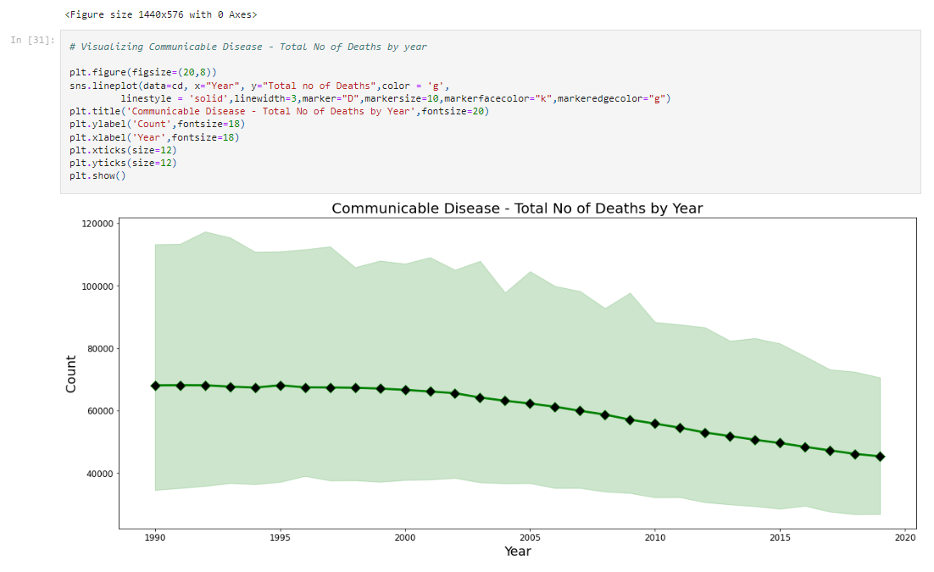
Data Visualization:
Communicable Diseases:
Death by Nutritional Deficiencies count is very high in India and low in Tanzania
Nigeria has the most death count by Malaria
Maternal Disorders death is highest in India compared to other countries
Death by HIV/AIDS is high in South Africa followed by Kenya
Tuberculosis, Lower Respiratory Infections, Neonatal Disorders, Diarrheal Diseases and
Protein-Energy Malnutrition death count is high in India compared to other countries
Based on the dataset we can see Communicable disease is in decreasing trend

Slide 26
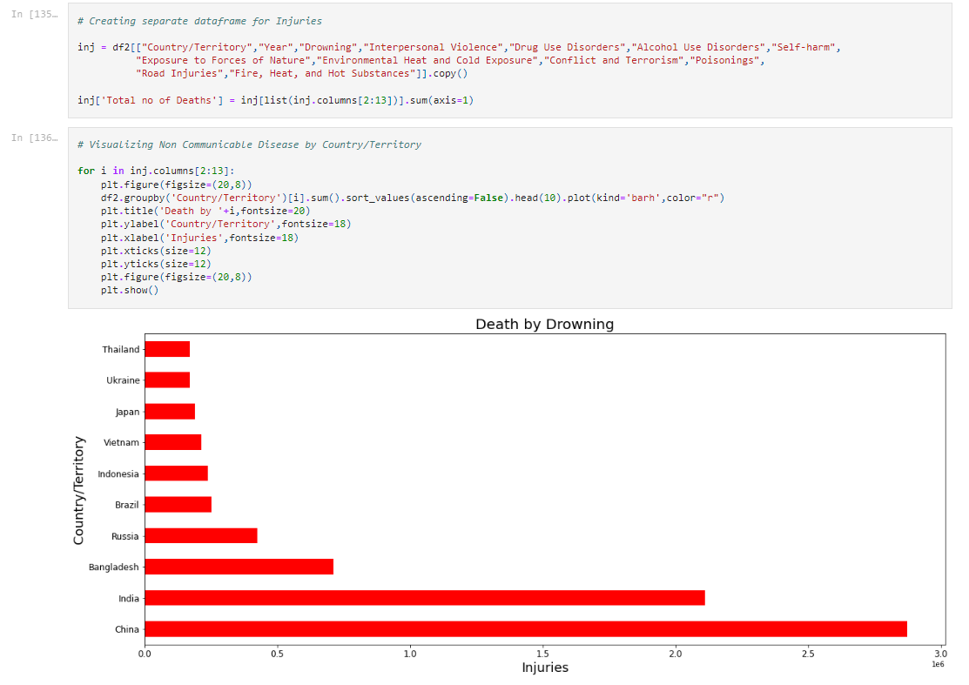
Data Visualization:
Injuries:
"Country/Territory","Year","Drowning","Interpersonal Violence","Drug Use Disorders","Alcohol Use Disorders","Self-harm","Exposure to Forces of Nature","Environmental Heat and Cold Exposure","Conflict and Terrorism","Poisonings",”Road Injuries","Fire, Heat, and Hot Substances"

Slide 27
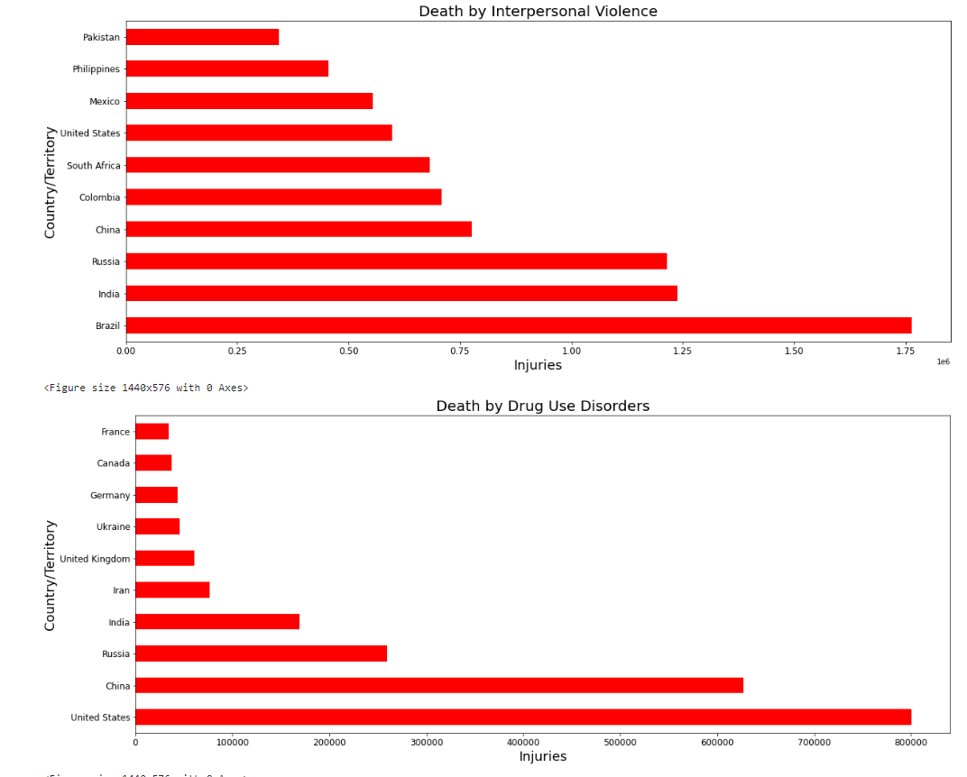
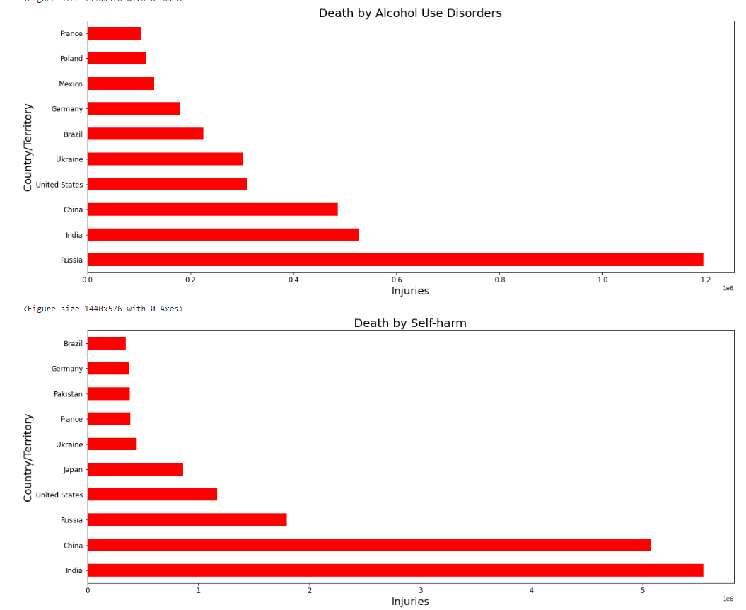
Data Visualization:
Injuries:

Slide 28
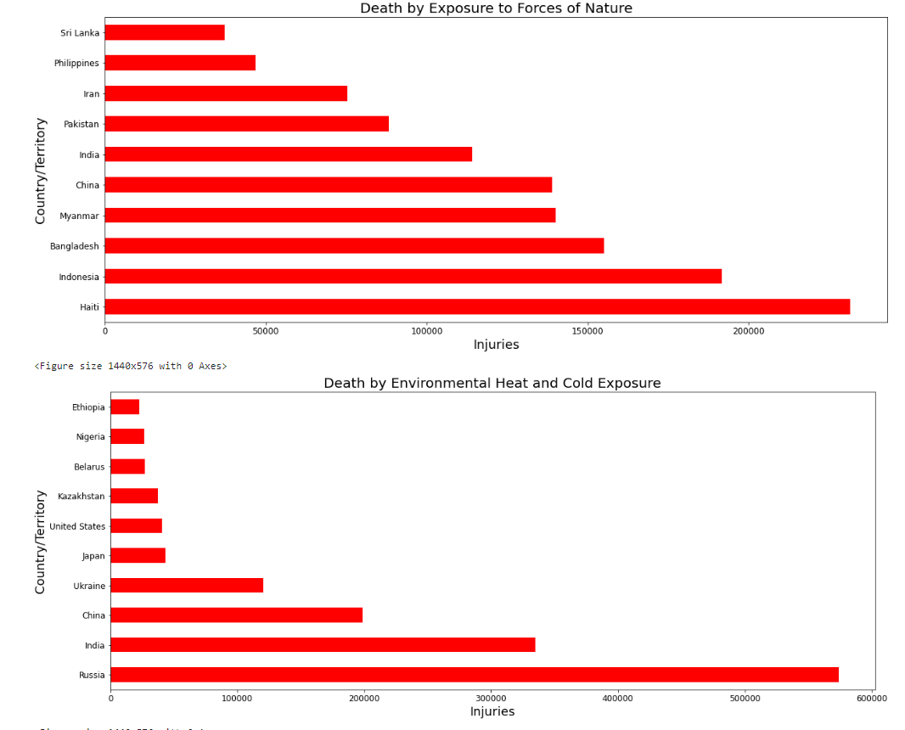
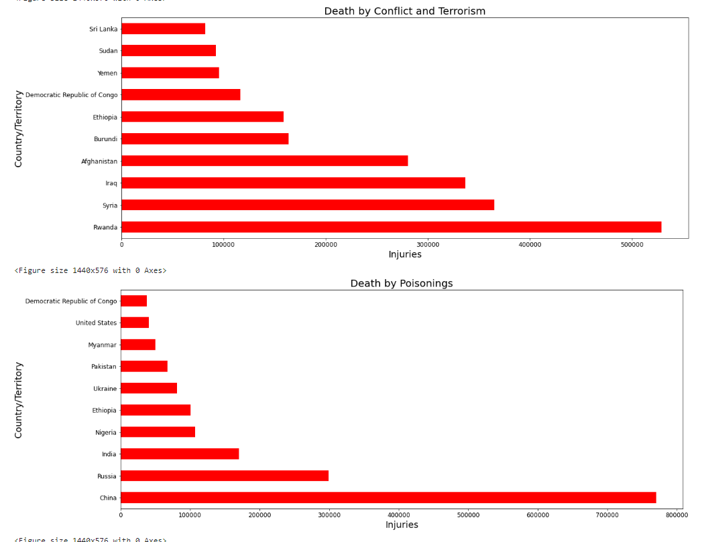
Data Visualization:
Injuries:

Slide 29
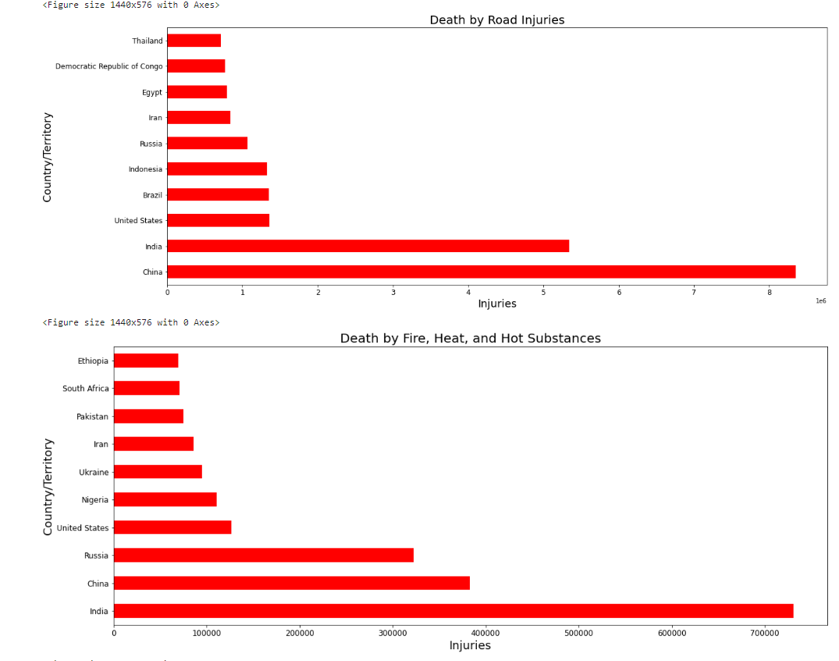
Data Visualization:
Injuries:
Drowning, Self Harm, Road Injuries, and Fire, Heat, and Hot Substances death count are high in China and India
Brazil got the highest death count by Interpersonal Violence
United States and China got the highest death count by Drug Use Disorders
Alcohol Use Disorder is high in Russia followed by India
Haiti, Indonesia and Bangladesh death count is high by Exposure to Forces of Nature
Environmental Heat and Cold Exposure death count is high in Russia
Conflict and Terrorism death counts are higher in Rwanda, Syria and Iraq
Death by Poisonings is very high in China across the globe

Slide 30
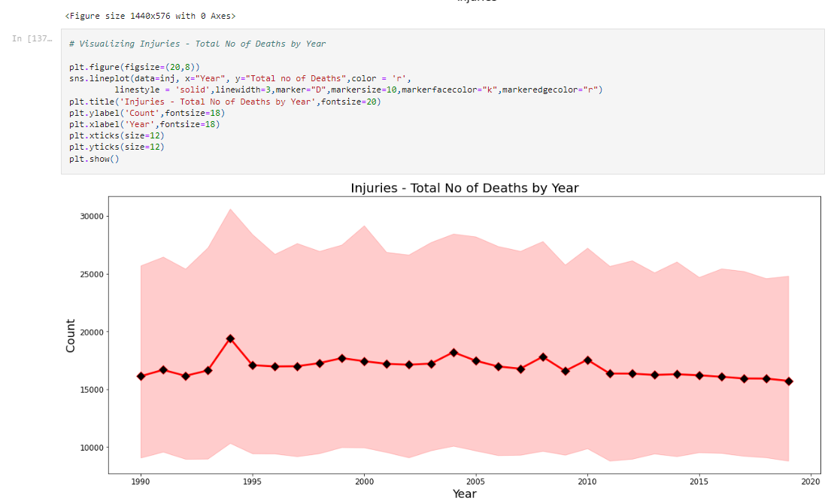
Data Visualization:
Injuries:
Death by Injuries is less when compared to Non communicable and Communicable disease,
based on the dataset we can see the death counts are almost same from 1990 to 2019

Slide 31
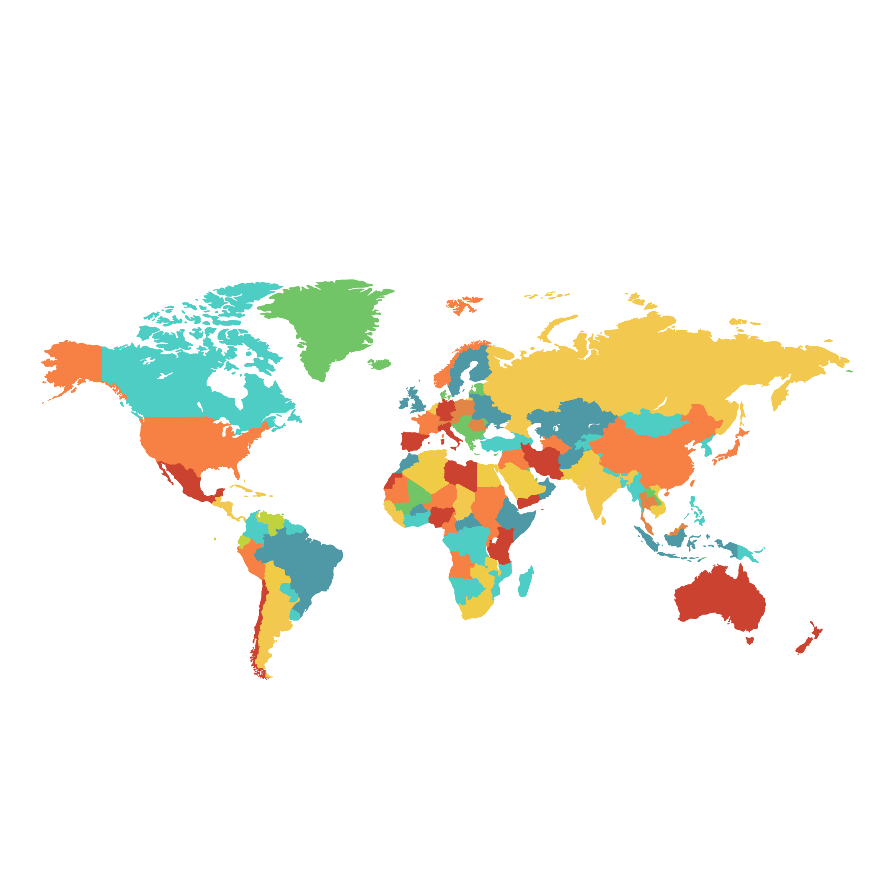
Conclusion
Non Communicable disease is in increasing trend and are responsible for one-in-three deaths in the world
Communicable Diseases that are caused by a pathogen which can be passed from person to person. This is where we have made most progress and still we are rapidly developing in this direction. Very few people die from rich countries compared to poorer countries. Many of these deaths can be prevented with modern technologies, such as vaccines, antibiotics, and public health infrastructure like sanitation and clean water. Maternal deaths, the deaths of newborns, and deaths from nutritional deficiencies are often closely linked to infectious diseases. Most of these are preventable.
Some major causes of deaths receive very little attention. Violence is, fortunately, a relatively rare cause of death. While it receives a lot of media attention, more people die from diarrheal disease than from all forms of violence put together and preventing deaths from diarrhoea would save more lives than bringing an end to all violence. We should be focusing on these areas as this should be less challenging to achieve.

Slide 32
Thank You
Presented by
Naveen Kumar Ranganathan

